Slide 1
Maths!
…‘I don’t get it.’

Slide 2
Maths can be intimidating. Fact!
Even the brightest student can find maths scary at times.
Students who struggle with maths find it scary most of the time!
Starting with the easy things.
Warm up with the basics.

Slide 3
THE EXAMINATION
Now changed….
Three papers (two calculator)
Out of 80 marks each paper.
Grades 1-9 (9 the highest, no longer A* to G)
More emphasis on remembering formulae , ratio problems and use of algebra.

Slide 4
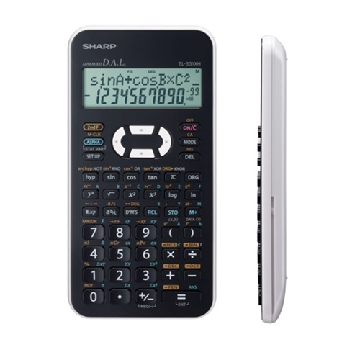
Available at most retailers

Slide 5
Maths is, in part, a memory test.
But where do you start? E.g
Write a “menu” of key facts –
Show working out.
Most of the time it’s simply just starting that is the hardest part.
The list of topics can be found from your child’s class teacher.

Slide 6
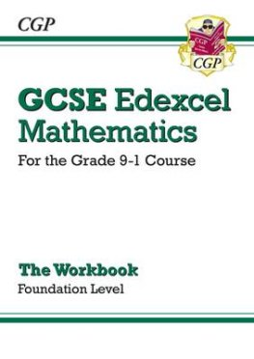
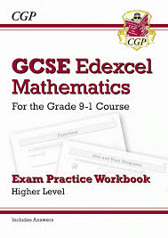
The revision guides…

Slide 7
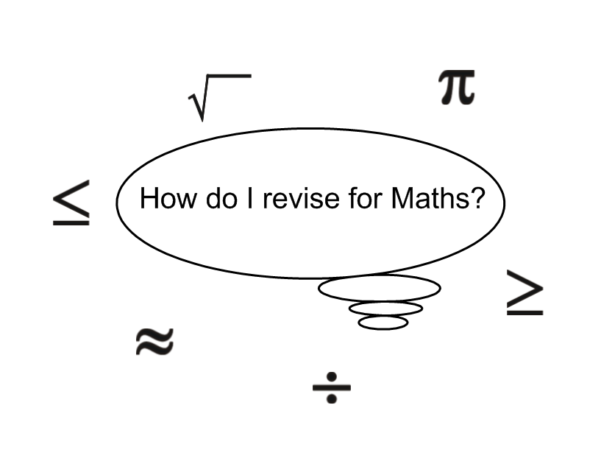

Slide 8
Start with the “half baked”
Topics first – i.e those you
Partly understand.

Slide 9
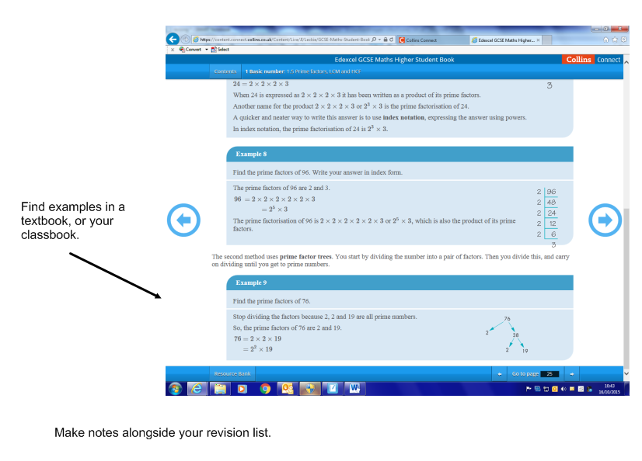

Slide 10
Rewrite in “pupil speak”

Slide 11
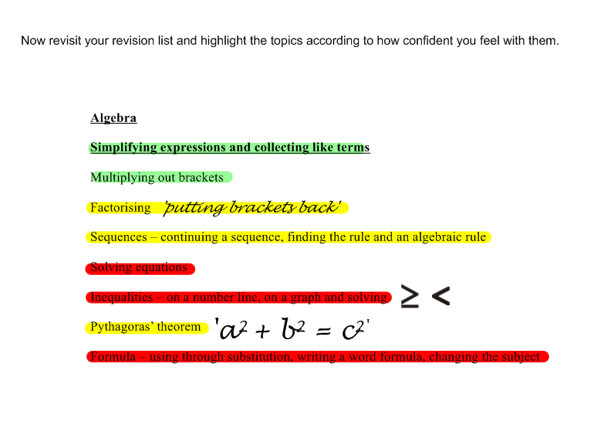
(See also the Powerpoint with revision topics.)

Slide 12
Consider 30 – 40 minutes maximum – don’t overdo it!!

Slide 13
LONGEST = ADD
SHORTEST = SUBTRACT

Slide 14
K C F

Slide 15
(Great – all have logins)
Maths Genie/Corbett Maths
CAUTION!! Do you need to use all the above sites ?

Slide 16
hegartymaths

Slide 17
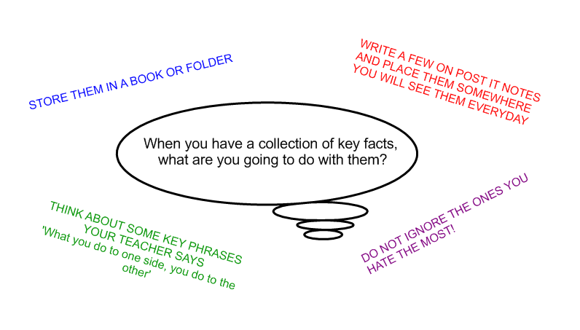

Slide 18
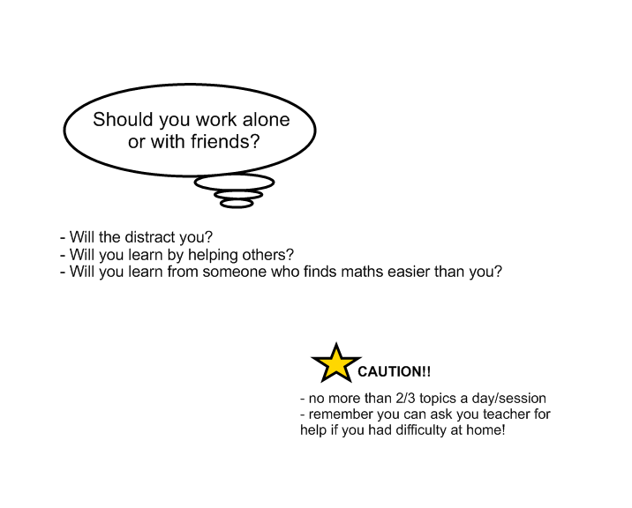
y

Slide 20
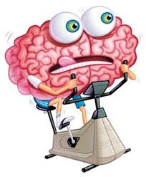
It’s a memory game!
Practise,
practise,
practise!
Key topics and basic
Skills score a lot of the
Marks together with
Written working!!

Slide 21
Revision in School
Timetabled with class teacher once a week.
Practice exam papers in class and topic ‘tests’
Ask to see these to find out how they are doing and see the topics they are finding difficult – look at their
Checklist.

Slide 22
If they are struggling, ask them to seek help from their class teacher and redirect them onto something easier.
Encourage them to write a list of the concepts they feel good about as well as those they need more help with. They need to celebrate their success.

Slide 23
Steps for Exam Success
Read the question twice before starting
Underline key words and phrases
Draw a diagram in pencil!
Write down your workings in steps (marks awarded for this – think like currency)
Double check you answer
You could get most final answers wrong , but with correct working you could still do well!

Slide 24
If you want a “quick start” guide then:
Buy a revision guide £2.50.
Work through it (answers at the back).
Use this as a basis to highlight topics you don’t quite understand
Logon to Hegarty maths

Slide 25
Keep Calm!
Revision is not intended to cause a battle at home.
Maths has a tendency to inspire feelings of stress and anxiety.
Thank you for your support!

