Slide 1


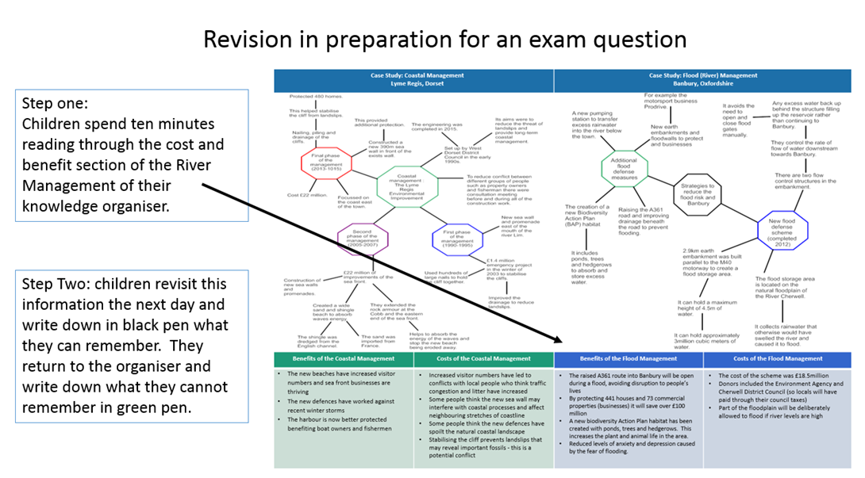
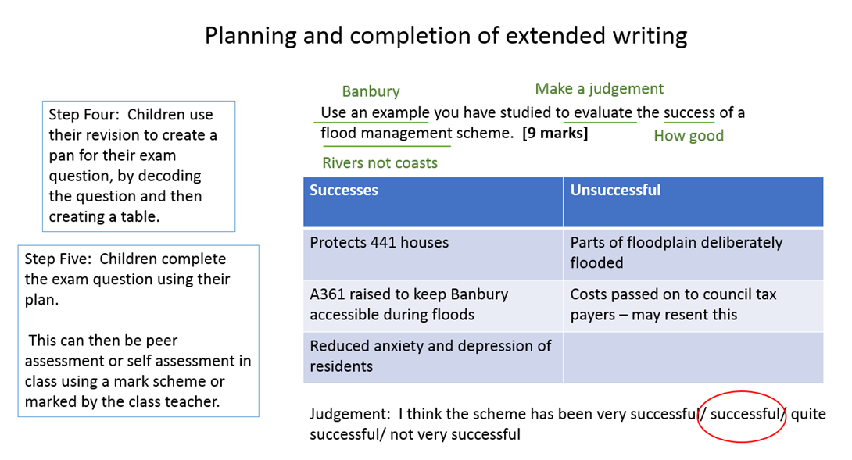
Homework Guidance
Department: Humanities (History & Geography)
HOD: Ms Sutton
Homework is an integral part of the children’s learning experiences. The purpose of homework is to consolidate and reinforce skills and content prior to the following lesson. It also aims to encourage pupils to develop the confidence, self-discipline and independence needed to develop organisational skills & foster revision habits.
Key Stage 3
At KS3 three pieces of homework will be set each unit of work, of which:
Two of these to be completed through the use of a ‘menu’ of choices from which the students choose the homework they want to complete. Two of these options will be creative including one ICT based, one will be the use of vocabulary and the other will be a written task.
The students need to choose one creative and one written task.
All staff will be using the same menu.
In addition, one homework will be preparation for their assessment. This revision will include attached support sheets and ideas of how to revise.
Year 7 will not be set any homework until the second half of the autumn term. Preparation for their assessments will take place the lesson before their assessment instead of a revision homework.
Key Stage 4
At KS4 a minimum of three pieces of homework will be set each half term. Two of these pieces of homework should be retrieval practice in the form of past questions from a previous topic.
The retrieval questions will be uniform across the department.
The retrieval questions will have revision notes attached and guidance to support the answering of the question.
The third homework will be preparation for their assessment. This revision will include attached support sheets and ideas of how to revise.
In addition to these three pieces of work, if staff feel it necessary to set additional work to support learning within lessons they can do so at their own discretion.

