Slide 1
Distance Learning using SMHW
You can access SMHW by using the App on your phone or tablet or on any laptop/computer using the internet.

Slide 2
Distance Learning using SMHW
You will be set work by your teachers which you must complete on the days you would have had that lesson.

Slide 3
Distance Learning using SMHW
Complete your work in line with your school timetable during the lessons you would have had that day.
Each piece of work should take no longer than 1 hour in duration.
Your timetable can be found on SMHW
Timetable

Slide 4
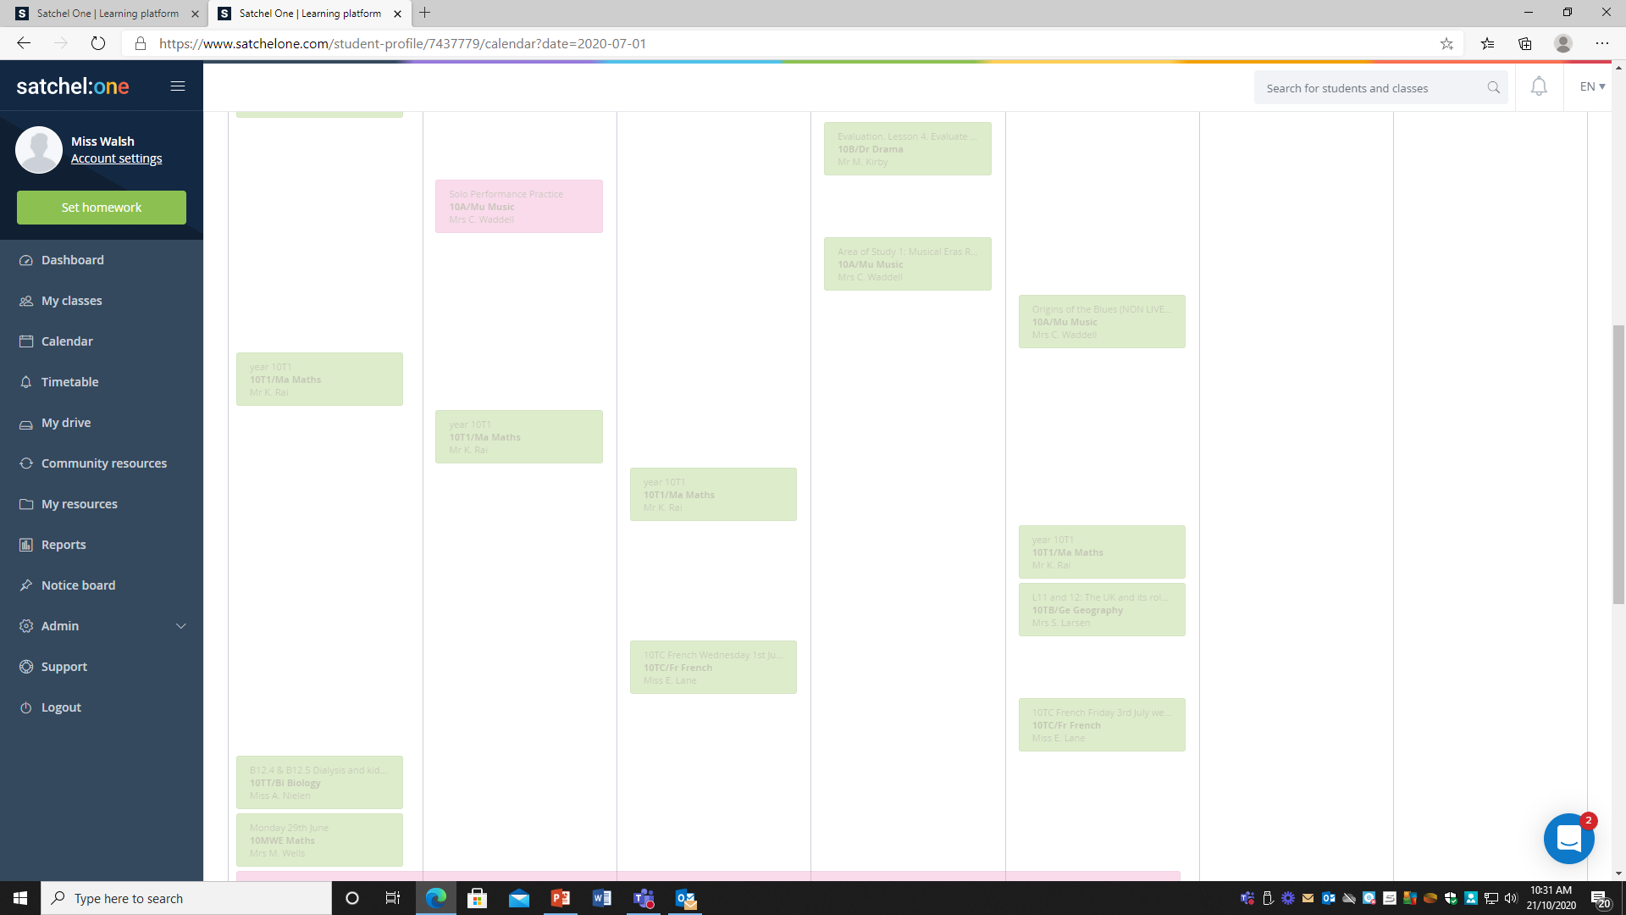
Distance Learning using SMHW
Some of the work set will be completed over a number of lessons, with your teacher breaking down what you have to do in each lesson.
Work that has been set on that day to be completed on that day will look like a green individual block. This must be completed
Pink Tasks are Flexible – these are tasks that add to the learning. They are optional.

Slide 5
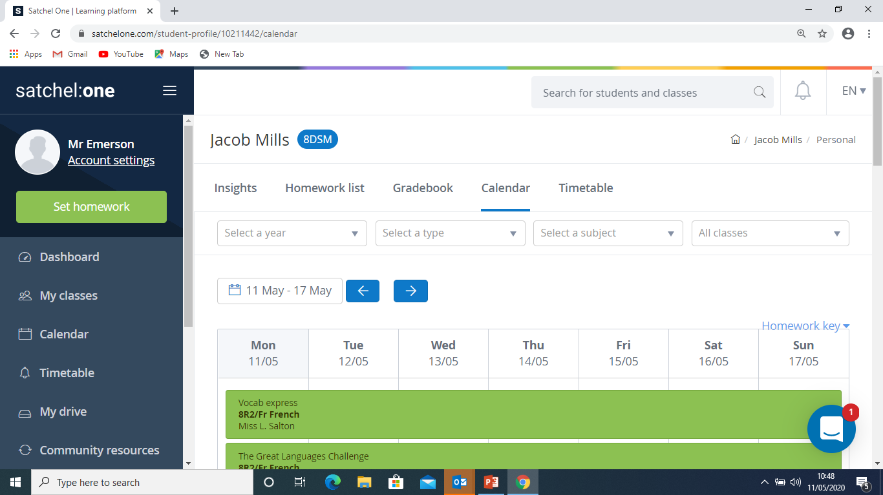
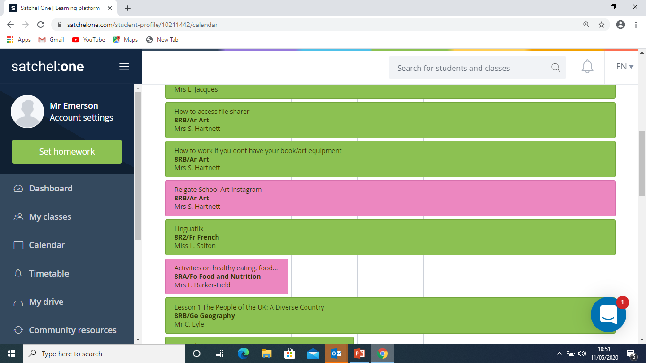
Distance Learning using SMHW
Use the calendar view of your work not the Homework List. The Homework list is confusing as it only shows the due date and this can sometimes lead to children missing work or ending up with a lot on one day.
Calendar View
Work to be completed

Slide 6
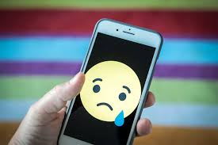
Distance Learning using SMHW
Please be aware that calendar mode is not visible on your phone.

Slide 7
Distance Learning using SMHW
You can contact your teacher at anytime through the comment section on the SMHW platform.

Slide 8
Distance Learning using SMHW
When you have completed work if you can please can you submit work through SMHW.

Slide 9
Distance Learning using SMHW
This can be done very simply as an attachment.
Simply click Submit Work
Then add attachment
Find the file and attach.

Slide 10
Distance Learning using SMHW
If you are having problems with submitting work please can you contact your teacher and let them know.
Email info@reigate-school.surrey.sch.uk with your teacher’s name in the subject box.

Slide 11
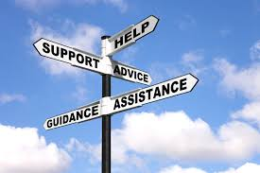
Distance Learning using SMHW
There are other ways to submit work which your teacher can advise you on if you can not do this through SMHW.

Slide 12
Distance Learning using SMHW
Accessing of work by children
You can access SMHW by or tablet or on any lap top/computer using the internet. using the App on your phone
You will be set work by your teachers which you must complete on the days you would have had that lesson.
Some of the work set will be completed over a number of lessons, with your teacher breaking down what you have to do in each lesson.
Use the calendar view of your work not the Homework List. The Homework list is confusing as it only shows the due date and this can sometimes lead to children missing work or ending up with a lot on one day.
Please be aware that calendar mode is not visible on your phone.
Complete your work in line with your school timetable during the lessons you would have had that day. Each piece of work should take no longer than 1 hour in duration.
You can contact your teacher at anytime through the comment section on the SMHW platform.

Slide 13
Distance Learning using SMHW
Submitting of work
When you have completed work if you can please can you submit work through SMHW.
This can be done very simply as an attachment.
Simply click Submit Work/then add attachment/find the file and attach.
If you are having problems with submitting work please can you contact your teacher and let them know.
There are other ways to submit work which your teacher can advise you on if you can not do this through SMHW.

