Slide 1
Virtual Prospectus

Slide 2
Overview
We have produced this presentation and various online videos to help you get to know our school and the staff. It is aimed at parents, carers and children to look through together.
If you have any questions, please email us at: info@reigate-school.surrey.sch.uk

Slide 3
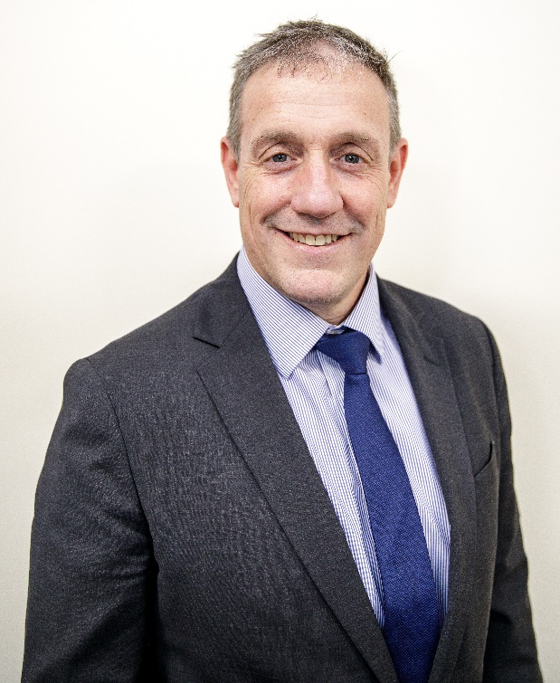
Heads Welcome
Headteacher, Mr Alexander, would like to welcome all children, parents and carers to Reigate School.

Slide 4
Virtual Tour
Welcome to our Virtual School Tour. Due to the current restrictions we are unable to have parents, carers and children touring the school.
To bridge this gap we have put together a virtual tour to give you a better understanding of Reigate School, its layout and what to expect when you join us in September. Please click on the video below to access the tour. We have also produced a drone video of the school.
https://vimeo.com/432462861

Slide 5
Meet the Departments
One of the main differences between primary and secondary school is the number of teachers that children meet during the school day. Children will move from lesson to lesson and be taught by up to five different teachers every day.
‘Meet the Departments’ introduces you to the Head of Department, and helps you understand what you will be taught during Year 7.

Slide 6
English
Hello and welcome to the English Department at Reigate School! During the first year, you will be studying a whole range of fantastic texts in your lessons, from novels, plays and poetry, to letters, newspapers and blogs - and of course you'll be dipping into Shakespeare as well!
There will be many chances to discuss, debate and present in your lessons as well as perform key scenes from the novels you are studying.
You will also get a reading lesson every two weeks in our wonderfully stocked library and be using the computer programme Accelerated Reader to track all the books you are reading.
Throughout the year there will be chances to meet real authors, visit the theatre and enter writing competitions to become published writers yourself!
Ms Williams - Head of Department

Slide 7
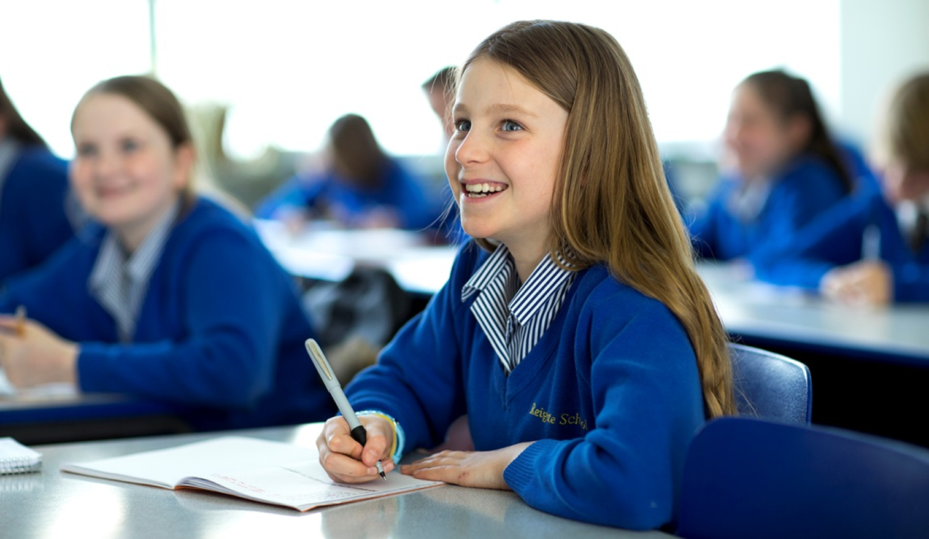
Maths
Mathematics is a creative and inter-connected discipline. Our department is passionate about Maths and we always try to pass this on through teaching and the activities that we arrange for you.
We use discussions, show-me boards and visualisers to support your learning. We start the year by looking at sequences and our algebraic thinking skills.
We look forward to seeing you all soon.
Mrs Wells - Head of Department

Slide 8
Science
I am Mr Kavanagh the Head of Science at Reigate School and I, along with the other Science teachers, welcome you to Science at Reigate School. We can't wait to get started and have some fascinating topics to begin the year with.
In the autumn term we will be looking at cells and organs. You will be hands on using a microscope and seeing organs like the heart, lungs and kidneys up close. The chemistry topic introduces particles and we will be using a Bunsen burner to help understand some physical changes. In Physics we will be looking at energy, specifically burning foods to see how much energy they contain.
What more could you want from the start of the year - flame, animal body parts and chemicals!
Mr Kavanagh - Head of Department

Slide 9
Geography
Hello and welcome to the wonderful ‘world’ of Geography! All the Geography teachers are looking forward to exploring our world with you, how it works and how we interact with it. We are the key to what the world will look like in the future.
During the first year we will be exploring the rainforest and deserts, investigating why the world’s population is growing and the challenges of both youthful and ageing populations.
We will also be looking at settlements and how they have grown up, and delving into the geography of food – where it comes from, and its impact on us and the environment.
Miss Sutton - Head of Department

Slide 10
History
Hello and welcome to the study of History at Reigate School!
You will be completing a fascinating tour of History in the Medieval period. You will find out why 1066 was such an important year - why medieval monarchs had so many difficulties, how the church made everyone good, why the Black Death was so terrifying and why a King was found in a car park. You will also begin to look at the colourful Tudor period and understand why a divorce fundamentally changed our country.
Studying the past is key to understanding the present so we are looking forward to exploring our History with you.
Mrs Thomas - Head of Department

Slide 11
MFL
Hola y bonjour!
The Modern Foreign Languages (MFL) Department is a really friendly, vibrant and fun place where you will learn both French and Spanish.
The MFL team will work hard to make your lessons enjoyable and memorable and we aim to boost your enthusiasm for reading, writing, listening and speaking in a foreign language.
Outside of the classroom, we offer a variety of French and Spanish clubs with lots of activities such as watching films, cooking, arts and crafts related to special occasions and we have exceptionally popular and exciting trips abroad.
We are really looking forward to welcoming you all in September.
Mrs Forrest - Head of Department

Slide 12
PE
Welcome to Reigate School. In PE you will get the opportunity to try a variety of sporting activities throughout the year, taught by a team of experienced and enthusiastic staff.
Some activities will have an 'individual performance' focus such as table tennis and gymnastics, whilst others will have a 'team-based' focus such as netball and football. Whether you have had previous experience or not in any of the activities really doesn't matter. At Reigate School we want you to have a go, try your best, but above all - enjoy!
PE activities may include: gym, hockey, OAC, badminton, basketball, table tennis, tag rugby, handball, dodgeball, football, netball, rounders, athletics, kwik cricket.
Mr Simmonds-Dance - Head of Department

