Slide 1
Online learning provision
Modern Foreign Languages
Bedrock - English
Hegarty - Maths
Educake - Science

Slide 2
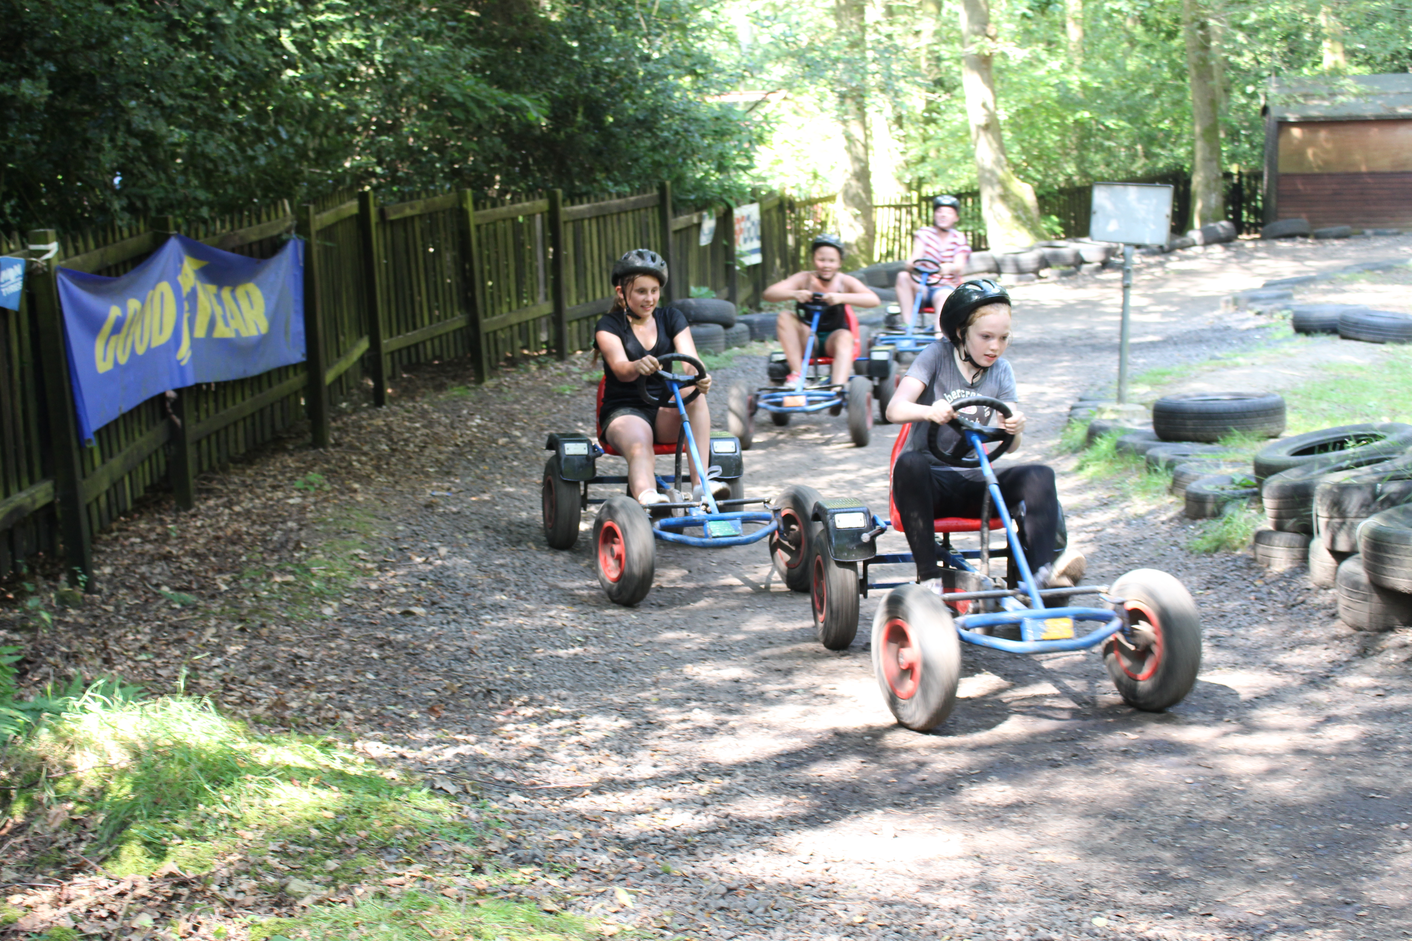
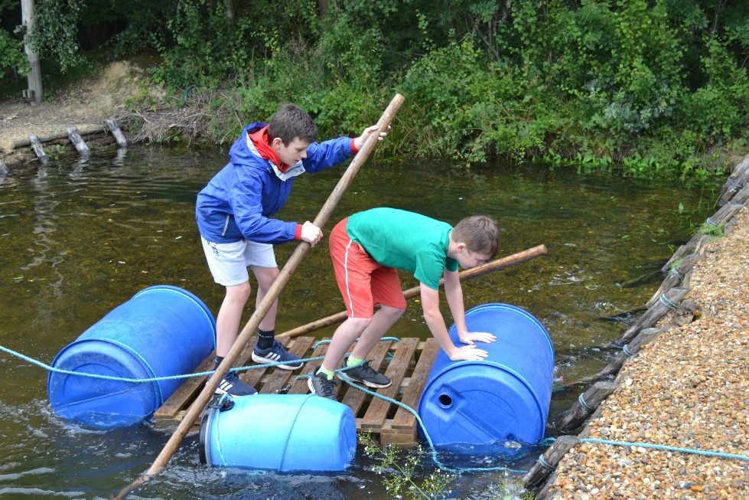
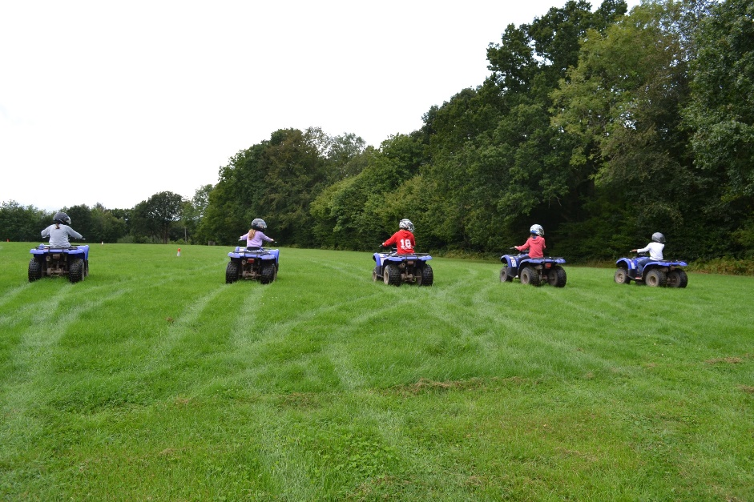
Year 7 Camp
In July all Year 7 children go on Camp to Bentley Copse.

Slide 3
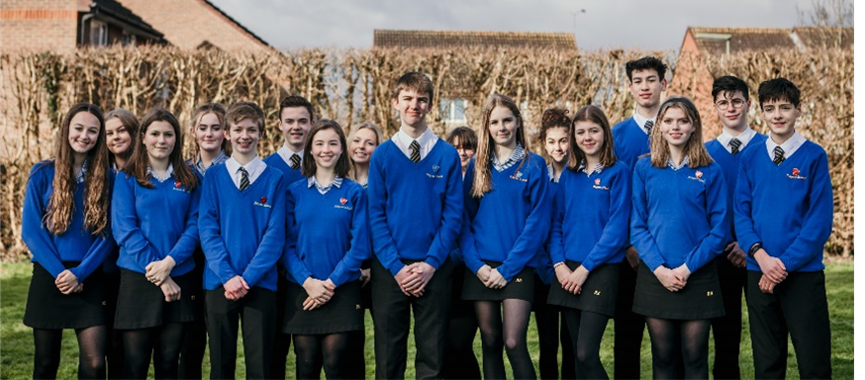
Thank You
Thank you for your time and I hope our virtual tour has been useful, informative and helpful in giving you a little insight into Reigate School before you join us.
If you have any questions about anything to do with Reigate School please contact us via info@reigate-school.surrey.sch.uk
We really hope you can join us in September and look forward to meeting you!

