Slide 1
Virtual Prospectus

Slide 2
Overview
We have produced this presentation and various online videos to help you get to know our school and the staff. It is aimed at parents, carers and children to look through together.
If you have any questions, please email us at: info@reigate-school.surrey.sch.uk

Slide 3
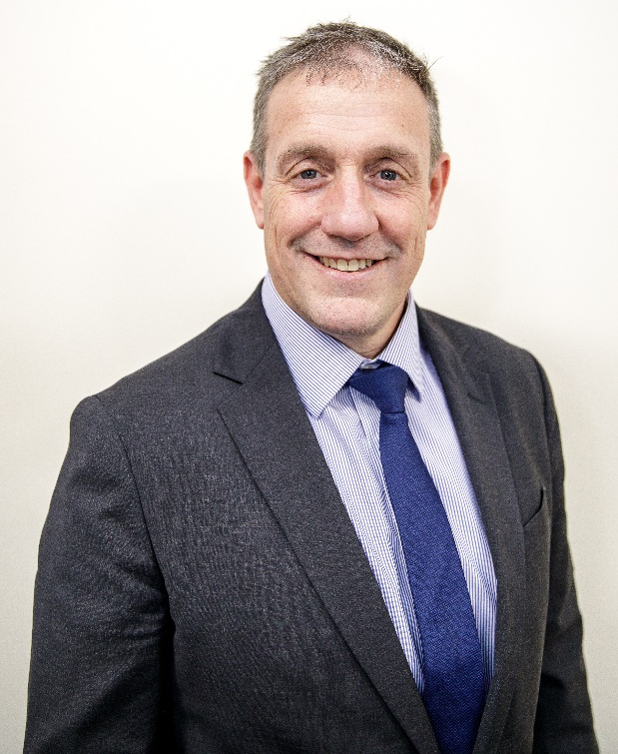
Headteachers Welcome
Headteacher, Mr Alexander, would like to welcome all children, parents and carers to Reigate School.

Slide 4
Virtual Tour
Our Virtual School Tour can also be found on the Year 7 Transition tab. We hope this gives you a better understanding of Reigate School, its layout and what to expect if you join us in September.

Slide 5
Meet the Departments
One of the main differences between primary and secondary school is the number of teachers that children meet during the school day. Children will move from lesson to lesson and be taught by up to five different teachers every day.
‘Meet the Departments’ introduces you to the Head of Department, and helps you understand what you will be taught during Year 7.

Slide 6
English
Hello and welcome to the English Department at Reigate School! During the first year, you will be studying a whole range of fantastic texts in your lessons, from novels, plays and poetry, to letters, newspapers and blogs - and of course you'll be dipping into Shakespeare as well!
There will be many chances to discuss, debate and present in your lessons as well as perform key scenes from the novels you are studying.
You will also get a reading lesson every two weeks in our wonderfully stocked library and be using the computer programme Accelerated Reader to track all the books you are reading.
Throughout the year there will be chances to meet real authors, visit the theatre and enter writing competitions to become published writers yourself!
Ms Williams - Head of Department

Slide 7
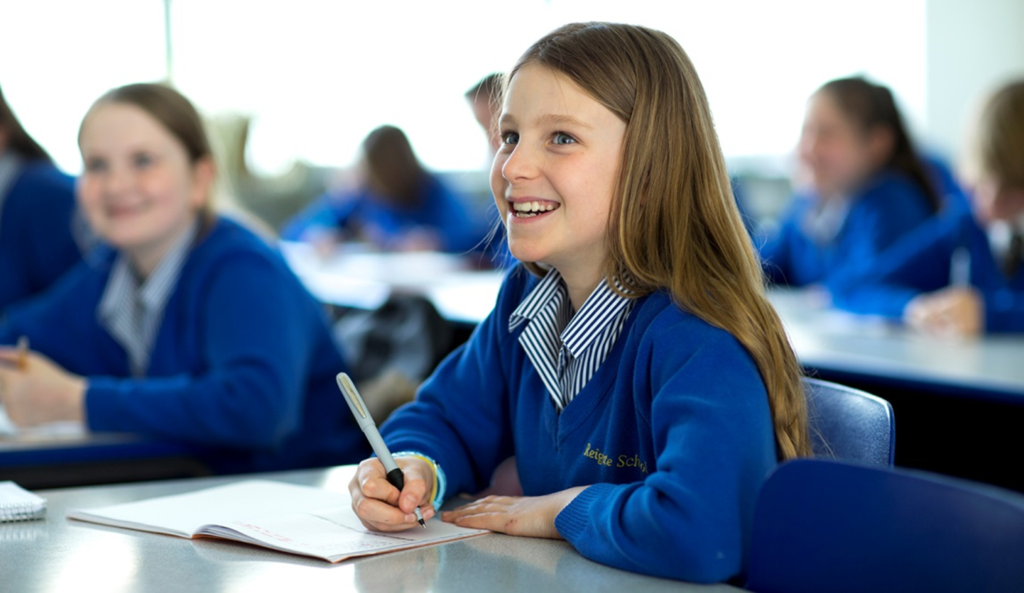
Maths
Mathematics is a creative and inter-connected discipline. Our department is passionate about Maths and we always try to pass this on through teaching and the activities that we arrange for you.
We use discussions, show-me boards and visualisers to support your learning. We start the year by looking at sequences and our algebraic thinking skills.
We look forward to seeing you all soon.
Mrs Wells - Head of Department

Slide 8
Science
I am Mr Kavanagh the Head of Science at Reigate School and I, along with the other Science teachers, would like to welcome you to Science at Reigate School. We can't wait to get started and have some fascinating topics to begin the year with.
In the autumn term we will be looking at cells and organs. You will be hands on using a microscope and seeing organs like the heart, lungs and kidneys up close. The chemistry topic introduces particles and we will be using a Bunsen burner to help understand some physical changes. In Physics we will be looking at energy, specifically burning foods to see how much energy they contain.
What more could you want from the start of the year - flame, animal body parts and chemicals!
Mr Kavanagh - Head of Department

Slide 9
Geography
Hello and welcome to the wonderful ‘world’ of Geography. All geography teachers are looking forward to exploring our world with you, how it works and how we interact with it. We are the key to what the world will look like in the future.
During the first year we will start by exploring some of the wonders of our world including the city of Petra and Victoria Falls. After this we will be looking at the living world exploring rainforests and desert environments, as well as dynamic landscapes of rivers, coasts and glaciers.
We will also be looking at urban areas, specifically how cities have built up and the challenges this can cause. This is followed by looking at the world’s population and why some countries have growing populations whilst others are ageing.
Miss Sutton- Head of Humanities

Slide 10
History
Hello and welcome to the History Department at Reigate School!
You will be completing a fascinating tour of History in the Medieval Period. You will find out why 1066 was such an important year, how historians have investigated the Silk Roads, why Medieval monarchs faced so many difficulties and why a King was found in a car park! You will also find out about why the Black Death changed England and how England has always been a country made up of lots of different types of people.
Studying the past is key to understanding the present so we are looking forward to exploring our History with you.
Mrs Thomas - Head of Department

Slide 11
MFL
Hola y bonjour!
The Modern Foreign Languages (MFL) Department is a really friendly, vibrant and fun place where you will learn both French and Spanish.
The MFL team will work hard to make your lessons enjoyable and memorable and we aim to boost your enthusiasm for reading, writing, listening and speaking in a foreign language.
Outside of the classroom, we offer a variety of French and Spanish clubs and we have exceptionally popular and exciting trips abroad.
Mrs Peckham - Head of Department

Slide 12
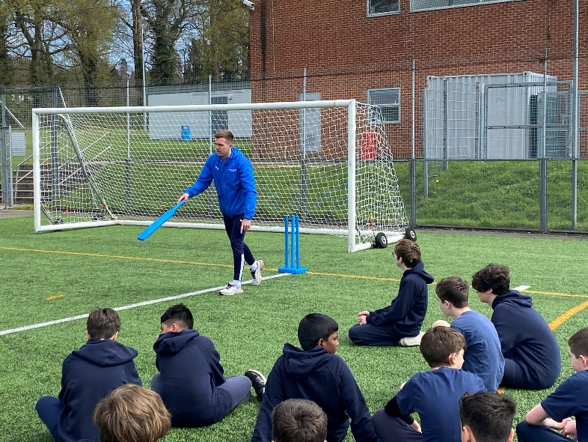
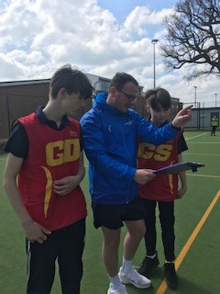
PE
Welcome to Reigate School.
In PE our ‘Sport for All’ philosophy means you will get the opportunity to experience a variety of sporting activities throughout the year, taught by a team of experienced and enthusiastic staff.
Some activities will be ‘individual performance’ focussed such as table tennis or gymnastics, whilst others will have a ‘team-based’ focus such as netball and football. Whether you have had previous experience or not in any of the activities really doesn’t matter, at Reigate School it is about participation, effort, engagement and enjoyment!
An example of PE activities include gym, Outdoor, Adventure and Challenge, badminton, basketball, table tennis, tag rugby, handball, football, netball, rounders, athletics and kwik cricket.
Mr Simmonds-Dance - Head of Department

