Slide 1
RE
We really look forward to welcoming you to RE. Everyone at Reigate School studies RE, and we look at some of the biggest questions about God, life and the Universe – such as ‘why are we here?’, ‘how did we get here?’ and ‘is there anything after this life?’.
We study three of the six main world religions, Hinduism, Buddhism and Sikhism, and also have a chance to learn some philosophy and ethics as well.
RE provides you with a great opportunity to discuss your ideas and to listen to people who think differently to you.
Mr Bowdery – Head of Department

Slide 2
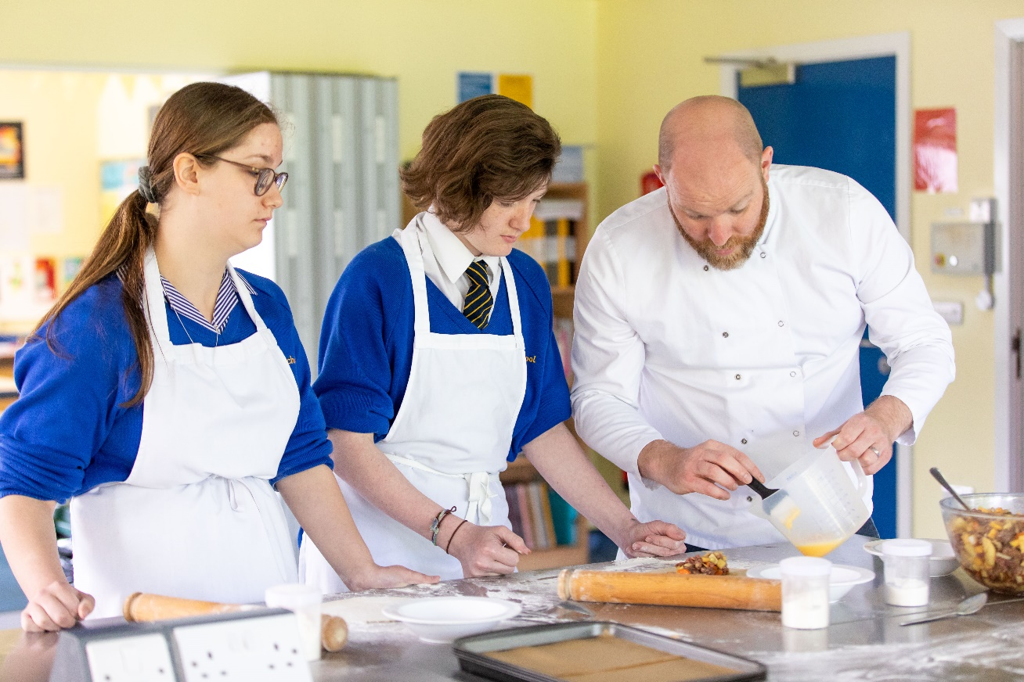
Food Technology
Welcome to the Food Technology Department where delicious smells of food are created! Here you will learn how to make healthy snacks, how to work hygienically and safely with food.
You will also learn about and use different pieces of equipment and we will even teach you how to wash up!
Some of the things that you will be able to make and take home to enjoy with your family include fruity muffins, flapjacks and scones. The treats await!
Mr Kent – Head of Department

Slide 3
Design and Technology
Design and Technology involves exploring how and why the everyday things around us are designed and made.
You will learn how to design and make products using a range of materials, as well as learn how to design using pencil and paper and also use computer aided design.
You will be taught how to safely make products with wood and plastic as well as exploring where the materials we use come from, how they are made and how they affect the environment.
Mr Kent – Head of Department

Slide 4
Business and Computing
Welcome to Reigate School Computing Department. At Reigate School you will have Computing lessons once a week and you will get to learn about Computers, Media and Business.
\
We will learn about how computers work and use them to create and edit digital video with music, voice overs and exciting visual effects. You will learn about the basics of programming and develop your very own games using the scratch programming language and we will also be investigating ways of creating a public event and making it popular with people in the local area.
Mr Moore – Head of Department

Slide 5
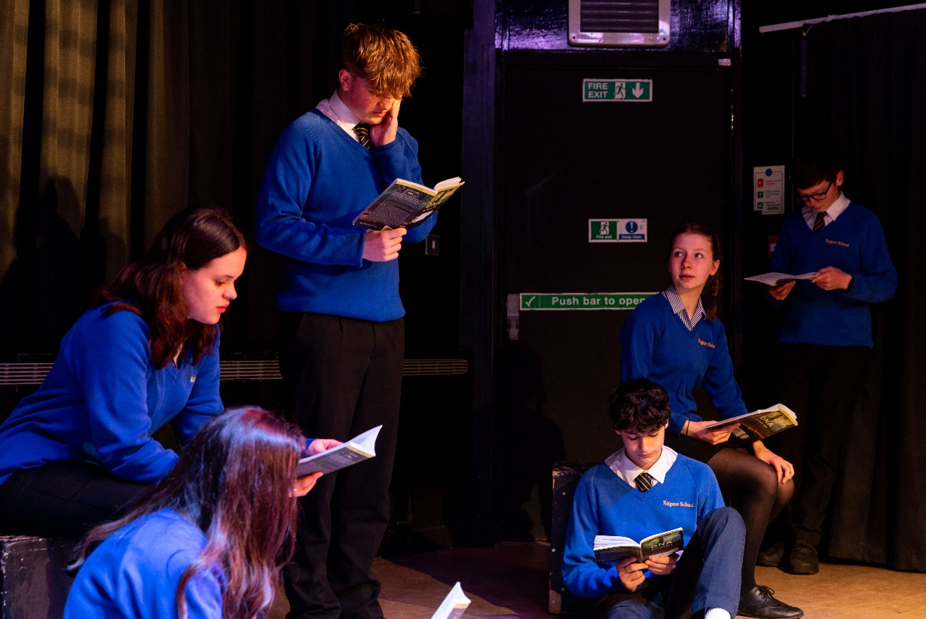
Drama
Welcome to Drama! In Drama you will be introduced to the wonderful world of the theatre and performance!
You will learn techniques such as role-play, hot seating and freeze frames. You will also learn performing skills as well as an introduction to various dramatic theorists and their styles.
Schemes of work include scripted work based on the plays of Bloods Brothers and Room 13 and devising (where you create your own one act play from scratch). These are all designed to help you understand, appreciate and enjoy drama – be it performing, planning or backstage roles.
We hope Drama will help you develop a better understanding of yourselves, of others and the world around you!
Mr Kirby & Mr Jones – Drama Department

Slide 6
Art
Welcome to Art! My name is Mrs Wilson and I am Head of Creative Arts at Reigate School: Art, Music, Drama and Dance! In Art you will be taught by Mrs Hartnett, Mrs Skinner or me! We will spend time going over some basic drawing and painting skills and learning to do some of those things that can be challenging - drawing and shading, mixing colours and painting skilfully!
We will also be looking at how art has changed through time, by learning to analyse different pieces of art! You will discover that a lot of what we do in Art is about experimenting and trying new ways of seeing, thinking and working, so expect to make lots of mistakes on your art journey, all part of the fun!
We hope that you enjoy Art lessons and hope also to see some of you in Art Club!
Mrs Wilson – Head of Creative Arts

Slide 7
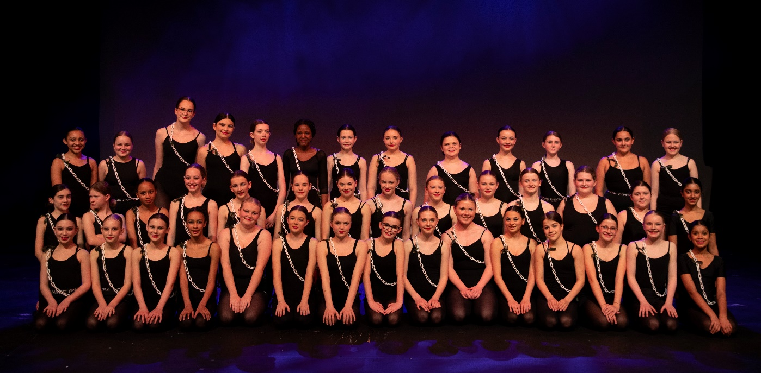
Dance
Hello and welcome to Dance here at Reigate School. I am Miss Swift and I will be your Dance teacher during your time here.
Every lesson is an opportunity to have fun, be creative and a chance to use up all of that energy you have. You will learn key dance terms, how to choreograph, dance pop quiz theory work and there will be many performance opportunities.
Alongside the dance lessons on your timetable there are also many dance clubs for you to try and the school musical and dance show performances to take part in.
I can’t wait to see you in the dance studio and I promise you will have the best time.
Miss Swift – Dance Department

Slide 8
Music
Welcome to Music at Reigate School! My name is Mrs Waddell, and I am very excited to welcome you to the Music Department.
We will learn how to read and write music notation, and will learn to play what you are reading and writing using a variety of instruments and technologies. Making music is the core of what we do at Reigate School, and there will be many opportunities for you to showcase your talents if you wish through extra-curricular activities, as well as our classroom tasks.
Mrs Waddell – Music Department

Slide 9
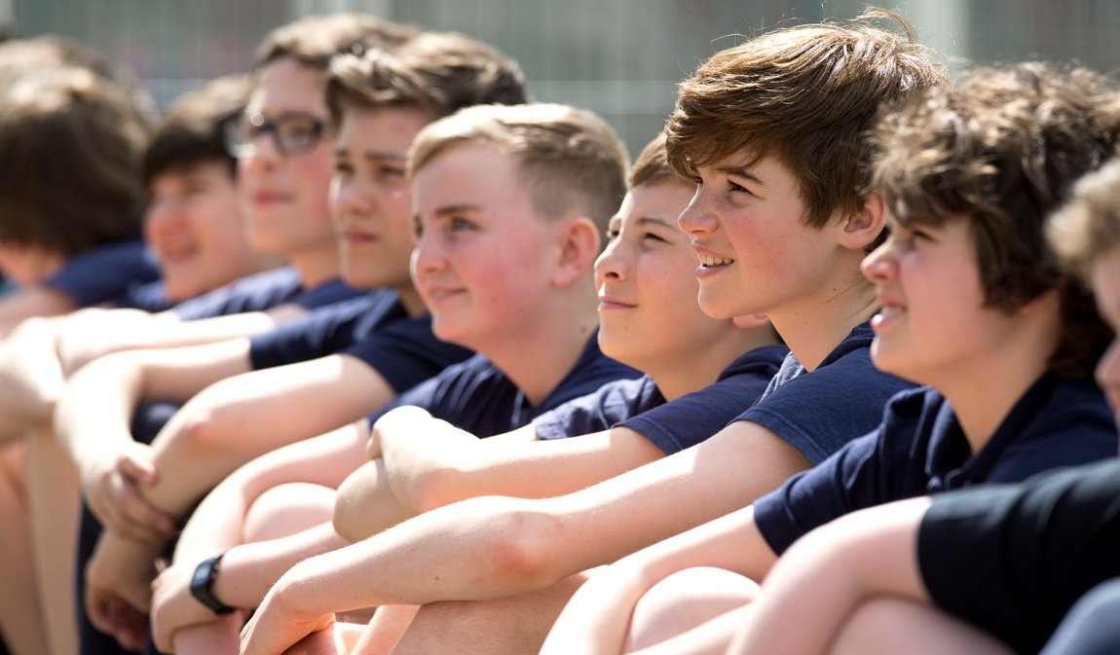
Special Educational Needs and Disabilities
If you have any specific SEND questions relating to your child’s needs, please do not hesitate to contact the school.
Parents and carers of children with SEND will be contacted in the first three weeks of the Autumn Term. The SEND Information Report provides an overview of SEND at Reigate School. This can be found on our website.
For any further information please contact the school via info@reigate-school.surrey.sch.uk

Slide 10
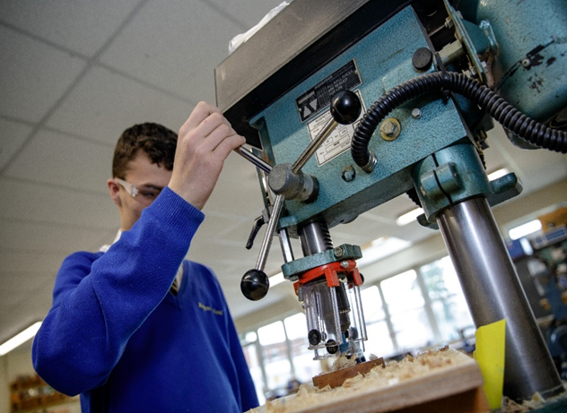
The School Day
8.45 – 9.05: Tutor time/ Assemblies
9.05 – 10.05: Period 1
10.05 – 11.05: Period 2
11.05 – 11.25: Break time
11.25 – 12.25: Period 3
12.25 – 13.00: Lunch
13.00 – 14.00: Period 4
14.00 – 15.00: Period 5

Slide 11
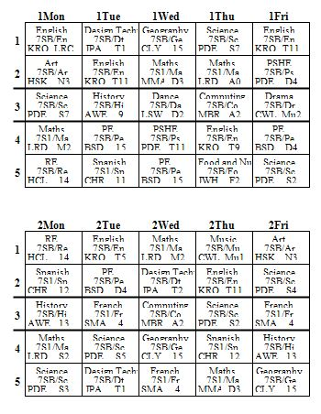
Timetable
An example of a Year 7 timetable is opposite. The timetable displays the following information:
Subject title
Class code
Staff code (full names will appear at the bottom of the timetable)
Room Code
All Reigate School timetables are based over a two week cycle and both weeks are different.

Slide 12
Attendance and Punctuality
Excellent attendance and punctuality is recognised through the rewards system
The expectation is 100% attendance
Children must arrive by 8.40am each day
Tutor time begins at 8.45am promptly
In the event of any absence or appointment, please contact the school absence line on 01737 245241 and press 1
If your child has a medical appointment please email info@reigate-school.surrey.sch.uk prior to the appointment
Please remember that attendance and achievement are linked.
Every day matters
96% attendance is the equivalent of 7 days absence a year. This is 35 hours of learning missed!

Slide 13
Equipment
You will need a bag large enough to hold:
Exercise books of various sizes including A4.
Text Books.
A pencil case. It is your responsibility to have containing the following items:
- Black pens, purple and green pens.
- HB pencils, ruler, eraser, pencil sharpener.
- Coloured pencils.
- Protractor, pair of compasses.
- Scientific calculator.
You will also need a PE bag large enough to hold full PE kit and appropriate footwear.
Your Form Tutor, Head of Population and subject teachers will regularly check your pencil case to make sure that you have all of the items on the checklist.

Slide 14
Scopay
This is the online payment system at Reigate School.
You will receive a letter with all the details on how to create an account before you start school.
This will allow your parents and carers to make payments to the school for trips, events and books and to Surrey County Council for school lunches.
You can also use your account for other tasks such as checking meal history and reprinting receipts

Slide 15
Canteen
At Reigate School we aim to fuse healthy and balanced nutrition with high street style dining offering our children a wide variety of tasty choices throughout the day.
We also provide safe access to quality food, cashless payment, easy top-up and irresistible choices for any needs. We are open from break to lunch.
We appreciate that a balanced and nutritious diet is key to a successful and healthy future.

Slide 16
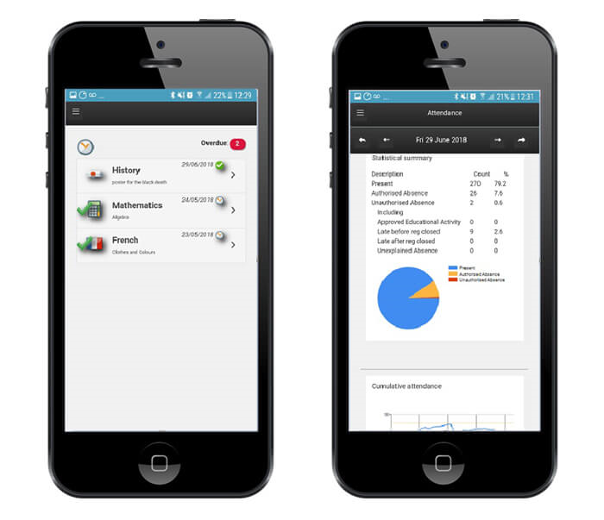
Insight
At Reigate School we use INSIGHT.
INSIGHT is designed to provide you with a greater level of access to the data we hold on your child and will enable you to see live updates on how your child is getting on in school.
INSIGHT can be accessed via a Mobile App or Website.
This is also where we issue termly reports. Parents and carers will receive a report at the end of each term.
You will be sent usernames and passwords for access.

Slide 17
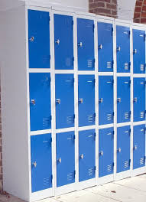
Lockers
School lockers are available to children should they like to have one.
Children are advised to use these to store belongings rather than carry everything around with them all day.
You will be able to reserve and pay for your locker via ScoPay. The cost will be £30. (£5 rental per year + £5 deposit)

Slide 18
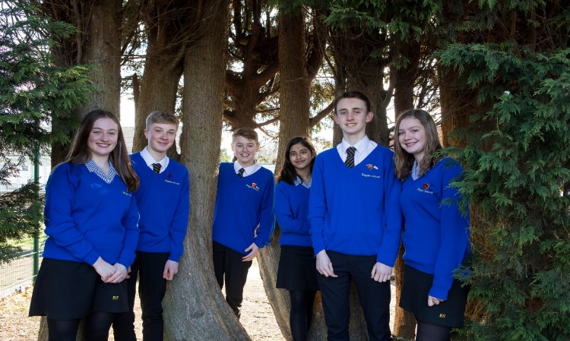
Uniform
The uniform policy is on the school website.
Just a reminder to please label clothes and belongings.

Slide 19
School Values
The Reigate School Values underpin school life and are the core characteristics that relate to character development within the school.
These were voted for by the school community of children, staff, parents & Governors.
They are KINDNESS, RESPECT, FRIENDSHIP, CURIOSITY & RESILIENCE.
Children will be given opportunities to show these values in action and be rewarded for showing positive character in school.

Slide 20
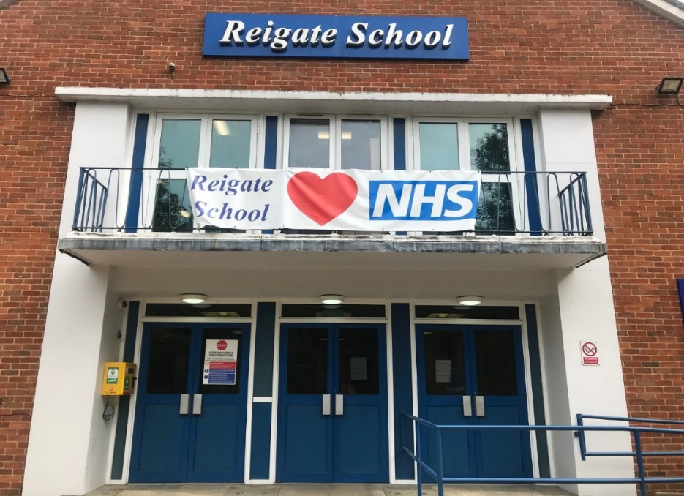
Behaviour Expectations
Our school behaviour expectations are simple: Children are expected to be READY, RESPECTFUL & SAFE:
READY to learn and participate in school life,
RESPECTFUL of the individual differences, opinions and values of other learners and adults in school, and
SAFE in their actions and behaviours towards others and themselves.
These three expectations will drive everything we do at Reigate and help shape the positive culture we want to see for our young people.

Slide 21
Achievement
Below are some of the ways in which children’s achievement is recognised:
Praise postcards
Head of School breakfast
Lunch queue passes
Achievement Points
Trips
House System

Slide 22
Extra-Curricular Clubs
We expect all Year 7 children to sign up to and attend at least one club before half term. Clubs are generally at no financial cost to you.
A list of these will be on the school website (and an example of the clubs that have run this year are opposite)
We will hold a Freshers’ Fayre event to promote clubs and teams within the year group.
Art Club
Choir
Football
Calm Colouring
Gymnastics
Enameling Club
Trampolining
Badminton
Dance Club
Kwik Cricket
Table Tennis
Yu Gi Oh Club
Rounders
Youth Theatre
Netball
Table Top Games
Rugby
Homework Club
Tech Club
Basketball
Athletics

Slide 23
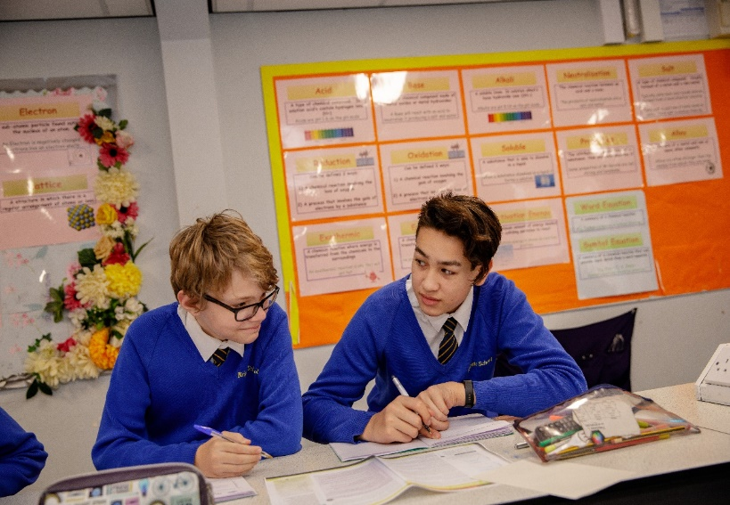
Homework
Will be staggered in the first year.
Parents and Carers can monitor homework via ‘Show My Homework.’
Term | Subjects
Autumn Term 1 (Sept/Oct) | English, Maths, Science
Autumn Term 2 (Nov/Dec) | Art, Dance, Drama, English, Humanities, Maths, MFL, Music, RE, Science
Spring Term/Summer Term | All subjects set homework as per homework policy

